Slide 1
EVs & the Southeast Grid
Utility Projects & Perspectives
Darren Epps
November 16, 2017

Slide 2
The situation has changed
World market dominated by China
Global auto emissions rules adding significant cost
Battery costs have fallen 77% since 2010
EVs may cost less than ICE to produce by 2025
Consumer awareness and interest is growing
Per mile cost of operations of an BEV or PHEV is already lower for high mileage drivers (Uber, Lyft etc.)
$10B of infrastructure and related investments committed
Sources: Bloomberg New Energy Finance, U.S. Department of Energy

Slide 3
New Model Launches: 2010-2020
49 New or Revised EVs Due Out Between 2016-2021
Source: EPRI

Slide 4
Why focus on EVs?
Infrastructure requirements
Proven market open for disruption by electricity
Utilities can accelerate the tipping point
Strengthen partnerships
Win-win for customers and grid

Slide 5
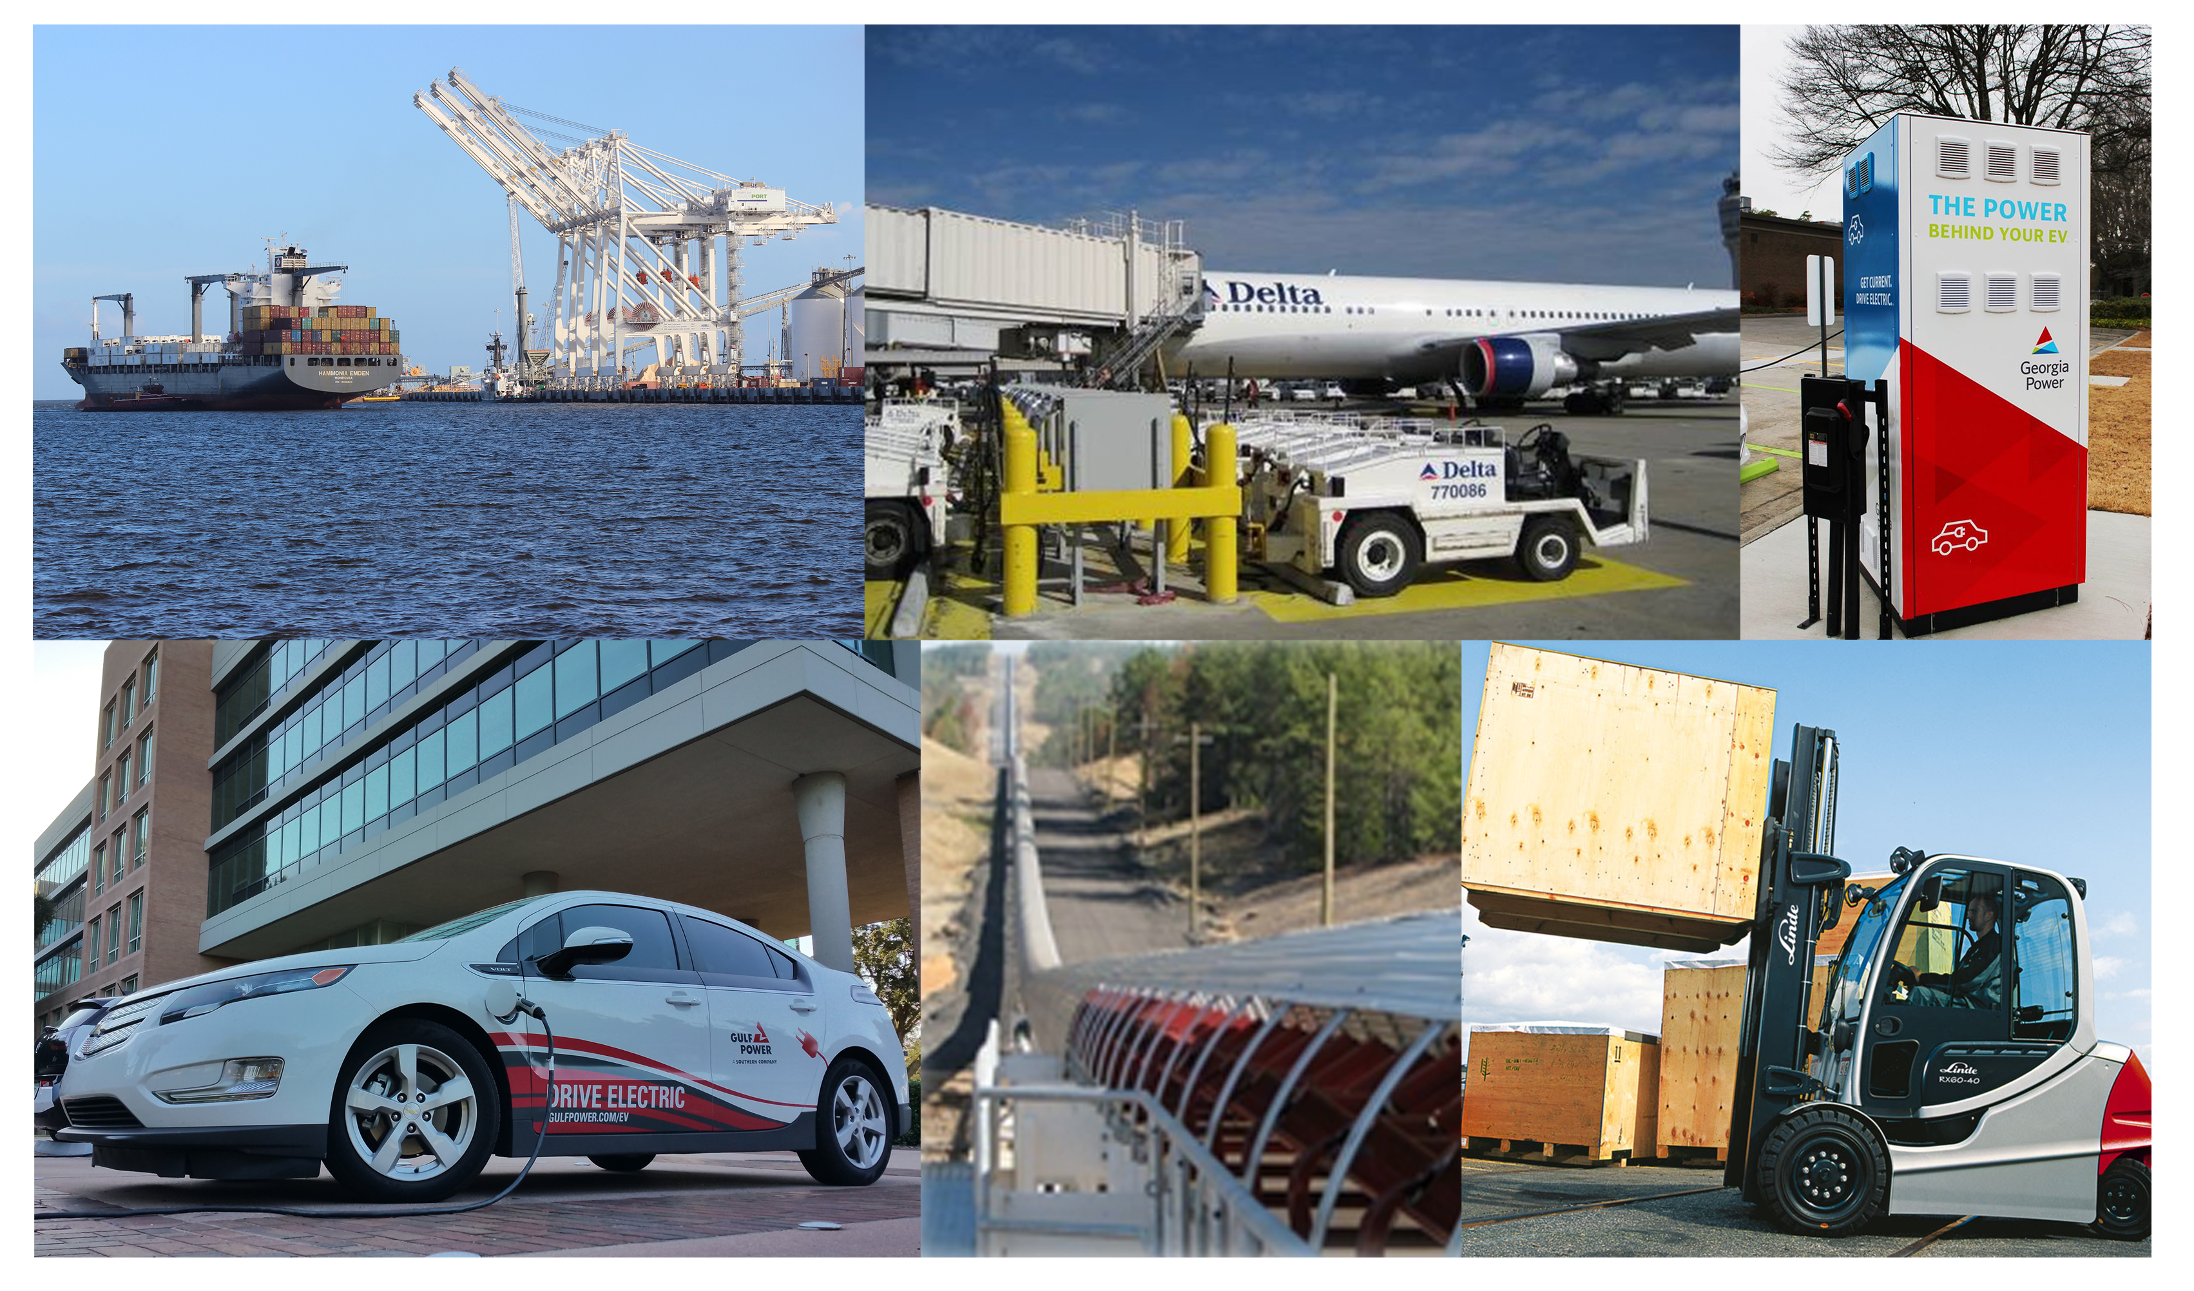
Southern Company’s Work

Slide 6
Southern Company’s Work
Growth
Readiness/Education
Leadership
R&D
Residential
Electric vehicles
Commercial
Fleet applications
Nonroad
Forklifts
Seaports
Mining
Airports
Overland conveying
Medium/heavy trucks
Truck refrigeration units
Lift trucks
EV rates and riders
Programs & incentives
Rebates
Infrastructure
Residential
Workplace
Community
Outreach
Ride and drives
Coffee & Cars
National Drive Electric Week
Internal
Partnerships and collaborations
EEI
EPRI
EDTA
Clean Cities
NGOs
OEMs
SO fleet
Charging technology
Network operators
Vehicle smart charging
Wireless
DC fast charging
Vehicle technology
Driveline efficiency
VIA truck demonstration
Autonomy
Alternative technologies
Fuel cell
CNG

