Slide 1
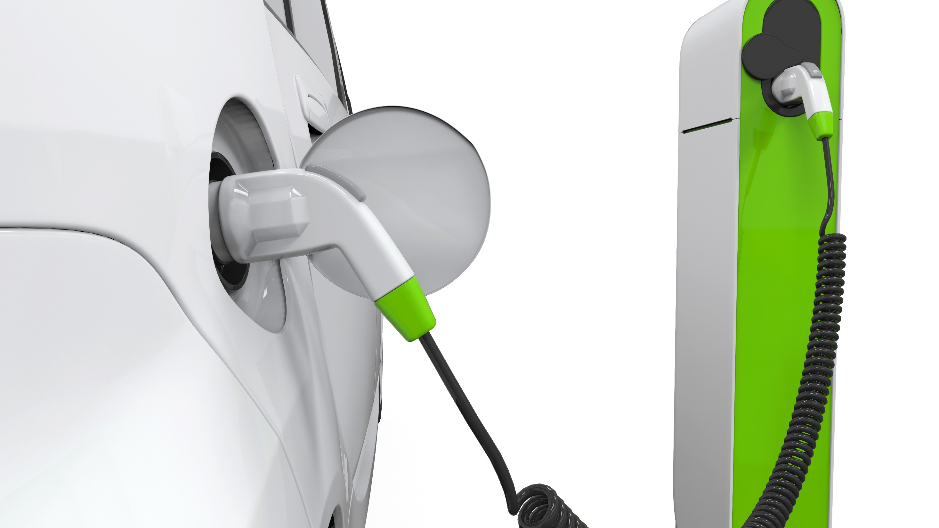
The EV Trend In The United States
Great Potential in Fleets
November 15, 2017
EVs & the Southeast Grid 2.0

Slide 2









Managing The Dragon
“How I’m Building A Billion Dollar Business In China”
Jack Perkowski Green4U CEO
In January 2017, took position as CEO of Green4U.
In 2009, founded Beijing-based JFP Holdings, a Merchant Bank for China.
A pioneer in China’s auto industry, noted for his expertise in doing business in China, with more than 20 years experience in the country.
In 1994, founded ASIMCO Technologies and built the company into an important supplier to China’s auto industry, well before others recognized the important role that China would play in the global auto industry.
Named one of “30 Outstanding Entrepreneurs in China’s Auto Components Industry During the 30 Years of Economic Reform” by China Auto News, the only foreigner to receive the honor.
Pioneered the development of local management; ASIMCO named three times one of the ten best employers in China.
20 years experience on Wall Street: Head of investment banking at PaineWebber in mid-1980s; negotiated a $350 million capital infusion into PaineWebber by Yasuda Life in the aftermath of Black Monday.
Graduated Cum Laude from Yale and as a Baker Scholar from Harvard Business School. Played in the famous “29-29 Tie” between Yale and Harvard in 1968.
“I’ve just finished Managing the Dragon, which I thought was fantastic. I was riveted by it. I cannot believe what Jack Perkowski has accomplished and what an adventure he’s had.”
—Michael Eisner
“If you want to do business in China, Jack Perkowski is your man”
—Tom Brokaw

Slide 3


A rich heritage in racing and motorsports.
25 years experience designing and building high performance cars.
Mission:
Asset light business model that focuses on fleet customers in the U.S. United States.
Provide EV solutions that help our partners and customers grow their businesses and increase
profitability.
A portfolio of new technologies, including using lightweight materials.
Substantial auto manufacturing platform in Braselton, Georgia.
Leverages China’s auto infrastructure.

Slide 4
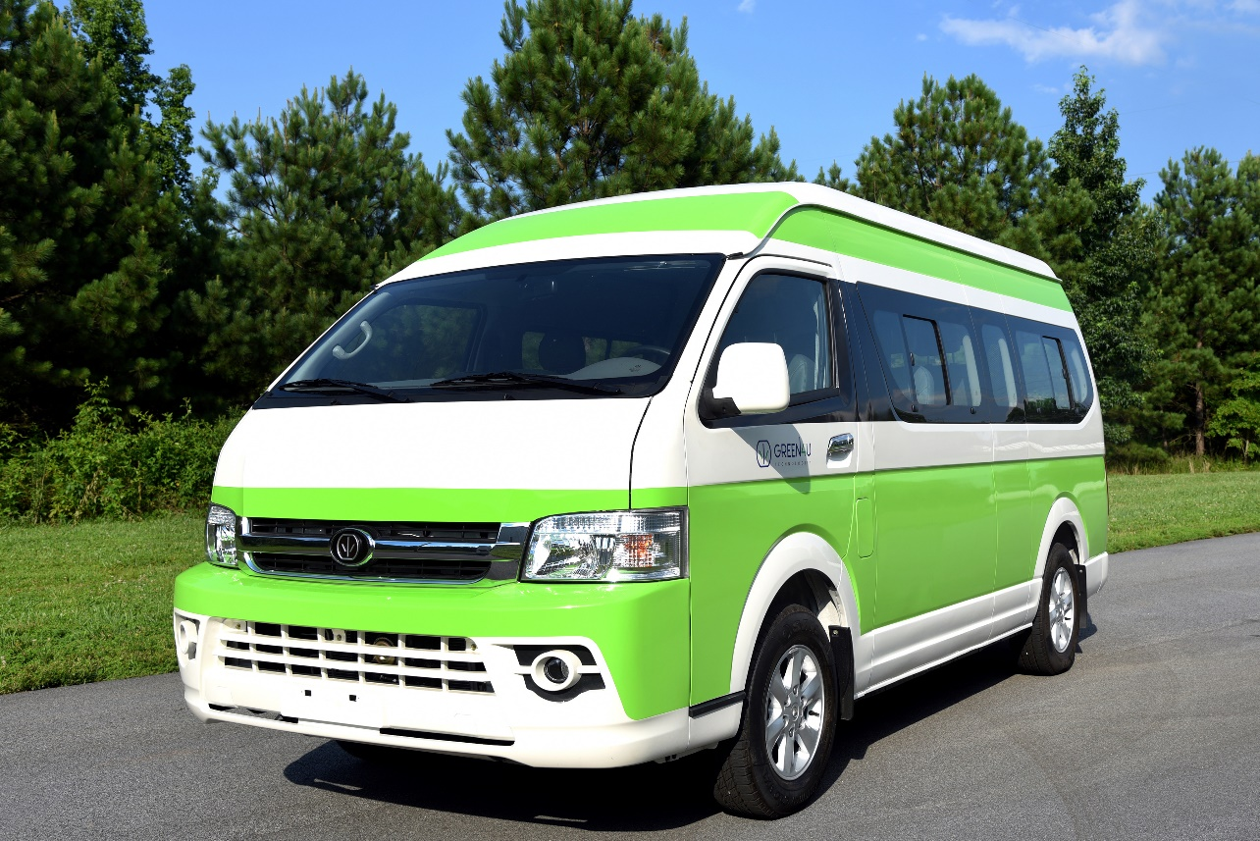
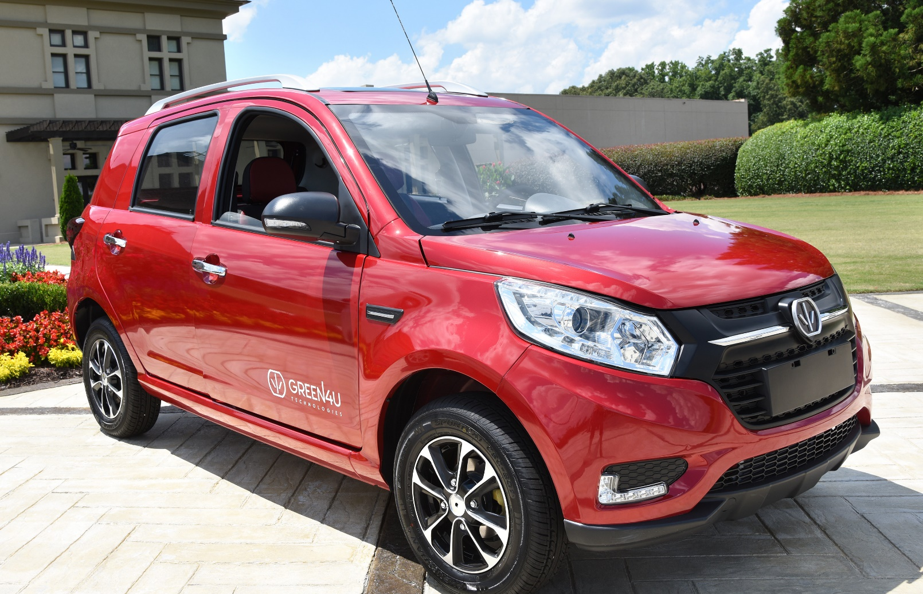

Passenger and Cargo Vans
Neighborhood Electric Vehicles
Green4U Vehicles
Stretch SUV and Four-Door Pickup Truck

Slide 5
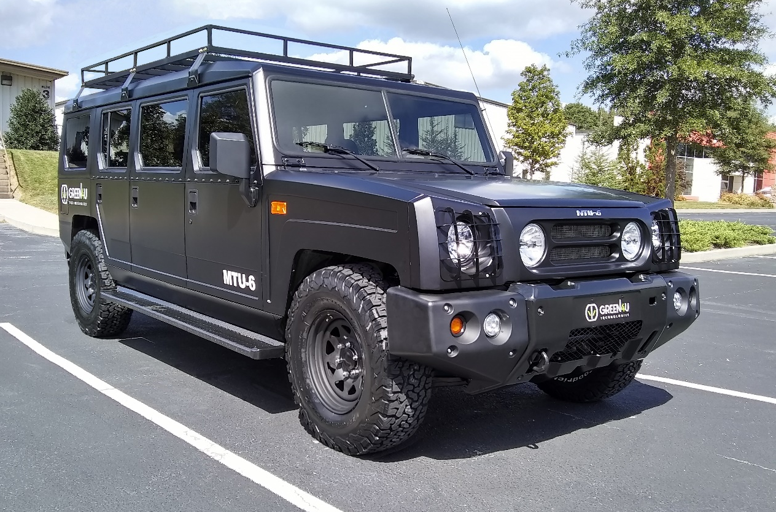
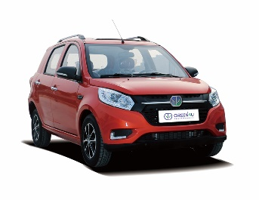
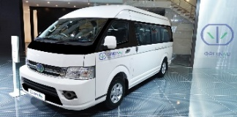

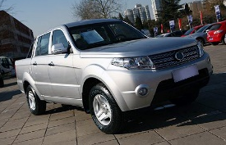
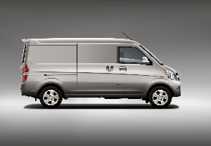
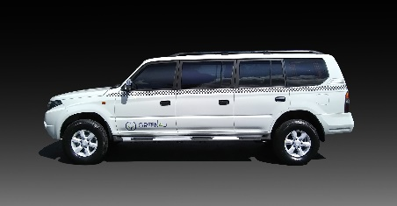
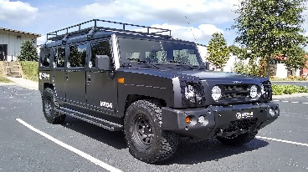

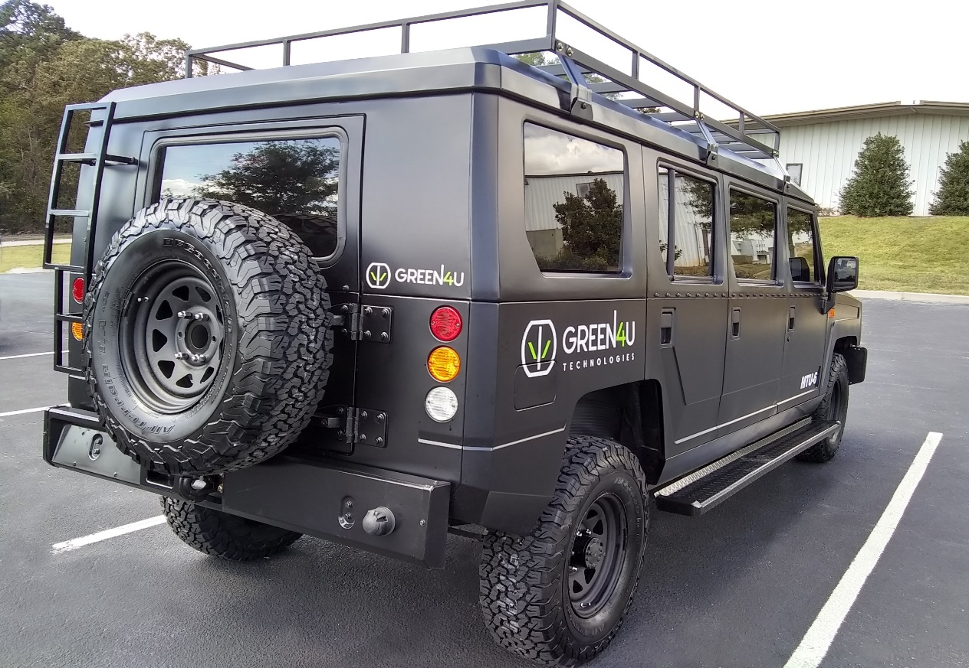
Rollout Schedule
NEVs
14 Seat Van
Four Door SUV
Pick Up Truck
Heavy Duty SUVs and Pickup Truck
Cargo Van
Six Door SUV
HD Six Door SUV
Sedan
Vehicle | Certification | Delivery Date
NEVs | 4 Months | 2017 Q4
14 Seat Van | 9 Months | 2018 Q3
6 and 8 Door SUV | 9 Months | 2018 Q3
Cargo Van | 9 Months | 2018 Q3
Pick Up Truck | 9 Months | 2018 Q3
SUV | 9 Months | 2018 Q3
Sedan | 20 Months | 2019 Q4

Slide 6
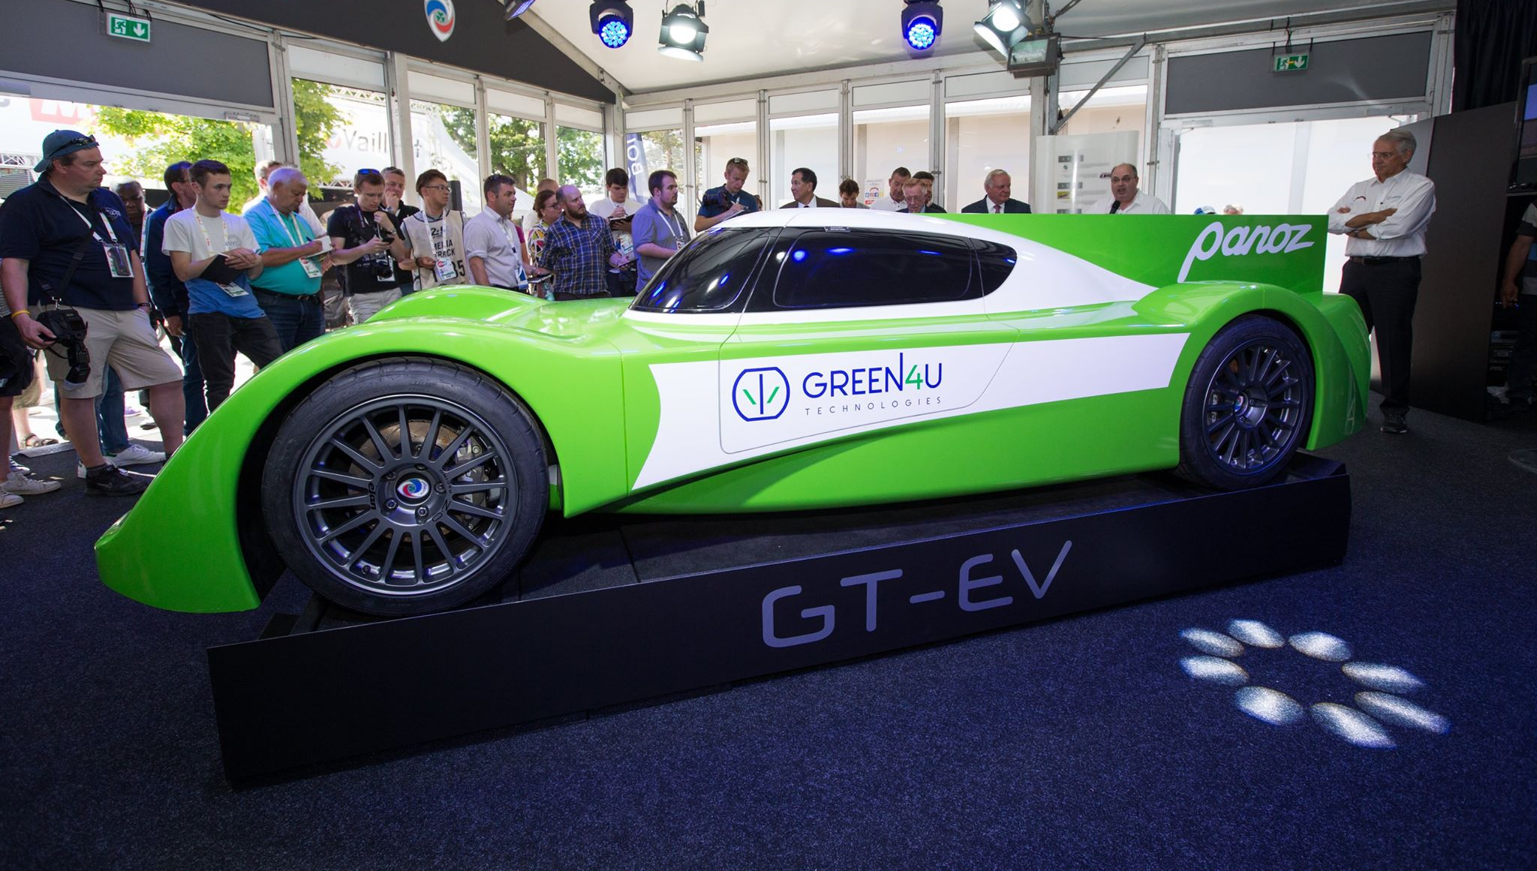
Green4U’s Racing Initiative
24 Hours of Le Mans
Contender for 2019 Garage 56
World’s most demanding auto race.
Garage 56 reserved for new technology car.
In June, Green4U displayed a concept car at Le Mans.
Official announcement for 2019 to be made in

Slide 7
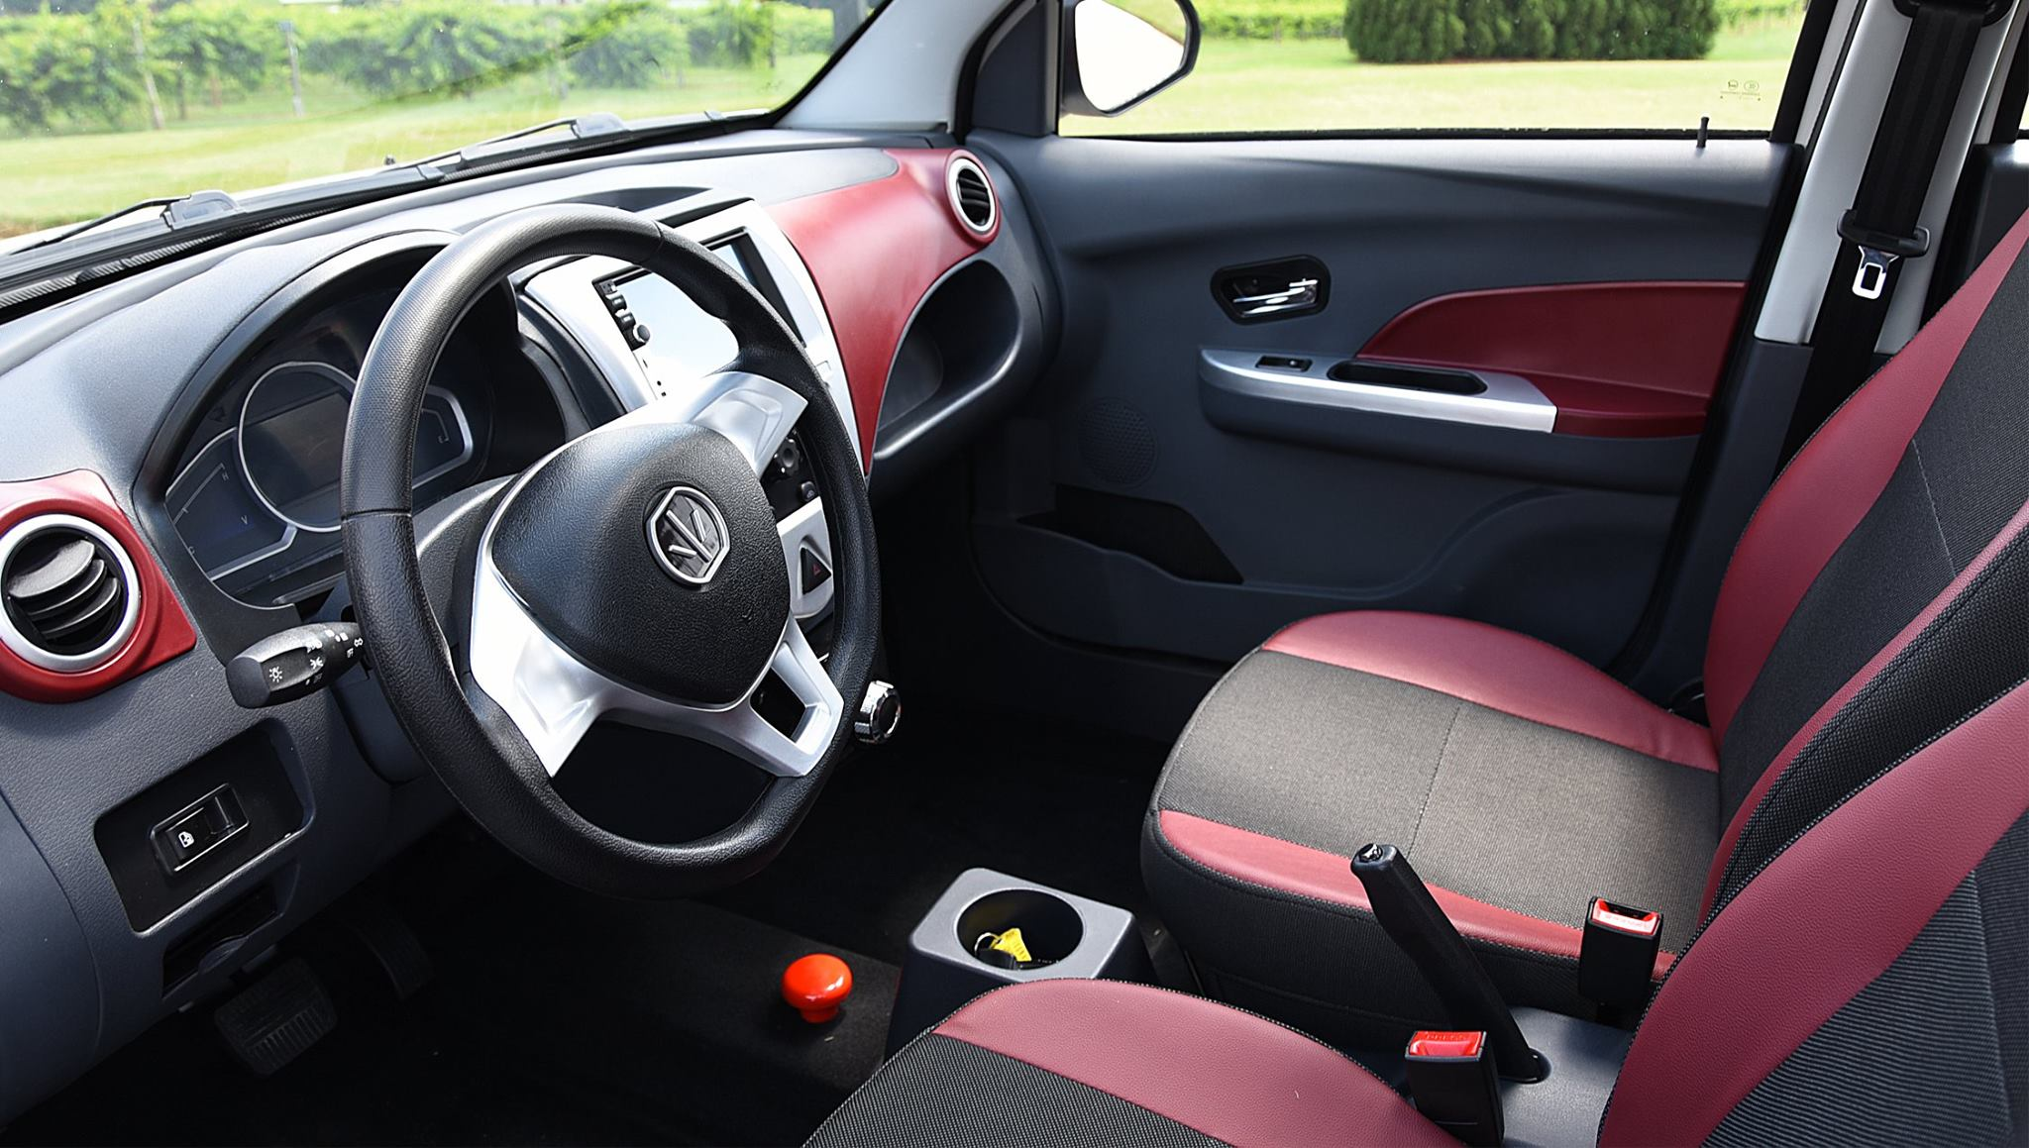
Global Vehicle Production
Rank | Country | 2016 Vehicle Production
1. | China | 28,118,794
2. | United States | 12,198,137
3. | Japan | 9,204,590
4. | Germany | 6,062,562
5. | India | 4,488,965
6. | South Korea | 4,228,509
7. | Mexico | 3,597,462
8. | Spain | 2,885,922
9. | Canada | 2,370,271
10. | Brazil | 2,156,356
Global EV Sales Are Still Small …………
2016
China 507,000 +53% *
Europe 222,200 +14%
U.S. 157,130 +36%
*In addition, approximately one million Low Speed Electric Vehicles were sold in China in 2016.
 | Rest of World | 19,665,001
 | Total | 94,976,569

Slide 8

But, U.S. Fleet Owners Want EVs
Who?
Taxi and Limousine Operators
Logistics Companies
School Districts
Public Transit Authorities
Municipalities
Universities
Military
Why?
Battery costs are 20% of what they were 5 years ago.
The charging infrastructure is being put in place.
Lower Total Cost Of Ownership (“TCO”)
Battery Pricing
Battery Type | Year | Cost ($/kWh)
Lithium Ion | 2016 | $145
Lithium Ion | 2014 | $200-300
Lithium Ion | 2012 | $500-600
Lithium Ion | 2012 | $400
Lithium Ion | 2012 | $520-650
Lithium Ion | 2012 | $752
Lithium Ion | 2010 | $750

Slide 9
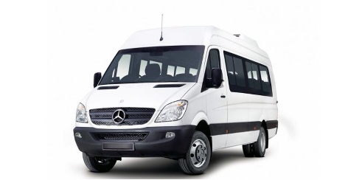
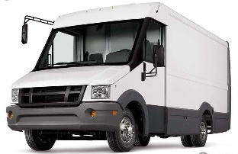
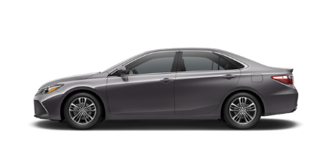
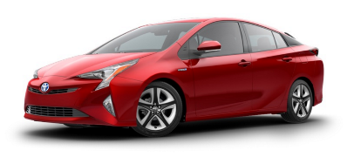
“TCO”
Lower Fuel And Maintenance Costs
Total Cost Of Ownership
Vehicle | Sprinter | Reach | Camry | Prius
Vehicle Use | Cargo Van | Cargo Van | Taxi | Taxi
Assumed Miles Driven Annually | 45,000 | 45,000 | 70,000 | 70,000
Annual Fuel Savings | $5,082 | $7,029 | $3,903 | $550
Annual Savings on Maintenance | $6,181 | $6,181 | $1,066 | $427
Total Savings Per Year | $11,263 | $13,210 | $4,969 | $977
Total Savings Over Five Years | $56,315 | $66,050 | $24,845 | $4,885

Slide 10
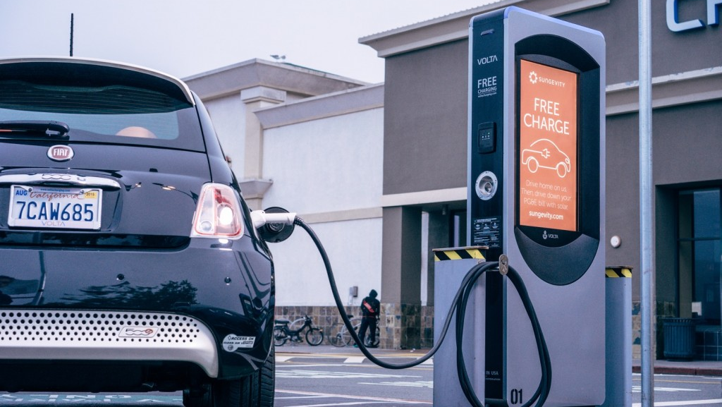
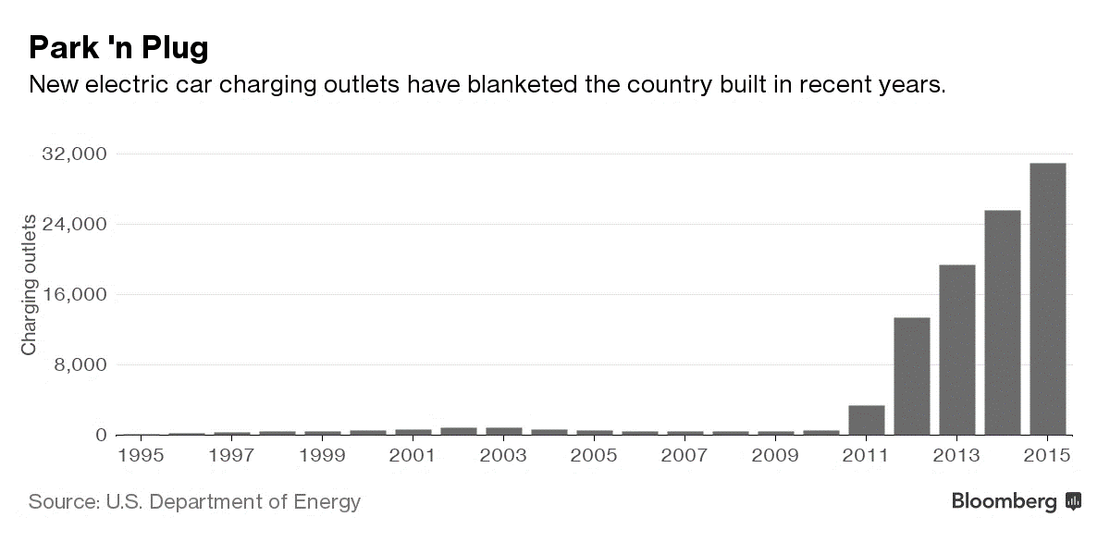
The U.S. Charging Infrastructure: Developing
Recent Developments
Electric car charging outlets in the United States by year
Park ‘n Plug
Cities across the U.S. are installing chargers.
California utilities are organizing a $1 billion package to electrify the state’s transportation sector.
Large chain stores like WalMart and Walgreens are installing AC Level 2 and DC Fast Chargers at hundreds of locations.

Slide 11

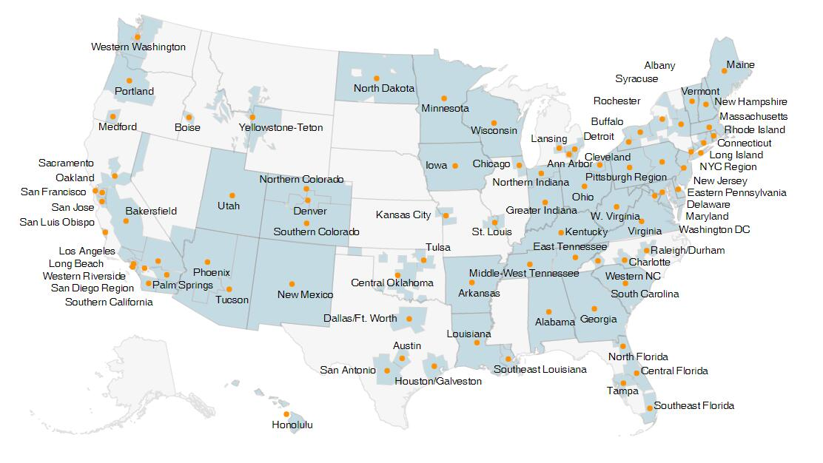
Who is Driving the EV Trend in the U.S.?
Clean Cities Coalitions
Cities: Want to be clean. Over 100 cities across America have formed Clean Cities Coalitions-
Electric Utilities: Want to sell more off peak power.
Companies: Want to be sustainable---and lower their operating costs.

Slide 12
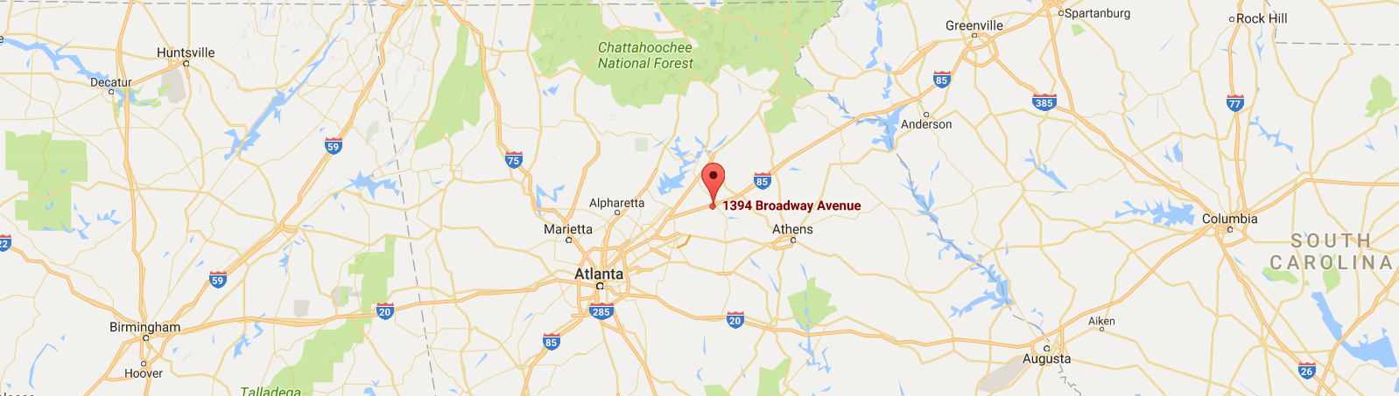
Green4U Technologies, Inc.
1394 Broadway Avenue
Braselton, Georgia
Our Email
Our Phone
Our Website
info@green4u.com
(1) 706-658-2030
www.green4u.com

